Slide 1
Sexual Abuse and Predator Prevention Protocol
Webinar Series 7 of 8
BROUGHT TO YOU BY
THE ASSOCIATION OF WALDORF SCHOOLS OF NORTH AMERICA
Notes:
Good Morning, Good Evening, Good Afternoon, ,…..to all of our attendees from literally across the globe.
This is the 7th of 8 webinars brought to you exclusively by the Association of Waldorf Schools of North America…My name is Sean Spellecy, I am the CEO of NewDawn Security, and I am your host for this series, And for those that are new to this webinar series….the purpose of this series to describe for you the work we do with schools to embed the Sexual Abuse and Sexual Predator Prevention protocols
NEXT SLIDE

Slide 2
Marysville Pilchuck/Private School Tragedy
3rd Party Contractor Forms:
http://school-security-consulting.com/
ELIZABETH NUGENT

Slide 3
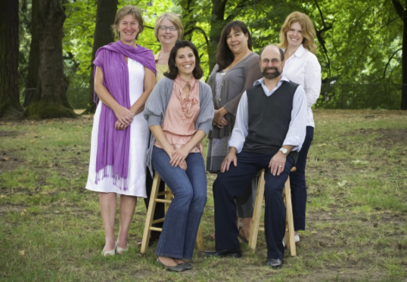
ELIZABETH NUGENT—SCHOOL CHAIR
CEDARWOOD WALDORF SCHOOL
Notes:
Elizabeth is a graduate of Portland State University, she began her career in Human Resources and Management, and then in September of 1988, became an Early Childhood Teacher at the Portland Waldorf School. She began working for the Cedarwood Waldorf School in 2005, and from 2006 to today, she has been the school chair at the Cedarwood Waldorf School in Portland, Oregon. I met Elizabeth a few years ago at a conference, and NewDawn Security and the Cedarwood Waldorf School began their relationship this past May. We were hired to help the school achieve the Excellence in Safe Schools Operation Certification, this certification process involves embedding risk mitigating actions framed around the 26 Safe School Standards, and one of those Safe School Standards is the 8 protocols of Sexual Abuse and Sexual Predator Prevention. I have asked Elizabeth to provide you some insights and ideas on how this process has impacted her school and her job, along with answering some of your questions, as most of you share the same title and job functions as Elizabeth. Personally, I want to thank Elizabeth for taking the time to join us this morning, she like all of you are extremely busy, and she, like you, sees the value in taking time to proactively enhance school safety and security….so please let me introduce Elizabeth Nugent.

Slide 4
PROACTIVE
AND PREVENTATIVE ACTIONS
FOR 3rd PARTY CONTRACTORS
Notes:
Today’s webinar focuses on the 7th^{h} of 8 needed embedded protocols, The proactive and preventative actions you can take with 3rd Party Contractors to not only decrease the chances

Slide 5
ELEMENTS OF PROACTIVE
AND PREVENTATIVE ACTIONS
FOR 3rd PARTY CONTRACTORS
WHO THESE PEOPLE ARE…..AND WHY THIS IS IMPORTANT
REMEMBER THE CHARACTERISTICS AND PROFILE
BACKGROUND CHECKS
IF ASSIGNED PERSON CHANGES OR CHANGES UNIFORM
IF SUPERVISING YOUR STUDENTS
Notes:
Vending Machine Distributers, Copy machine, Security Personnel, Tutors, After School Program Staff,

Slide 6
ELEMENTS OF PROACTIVE
AND PREVENTATIVE ACTIONS
FOR 3rd PARTY CONTRACTORS
EXPECTATIONS OF BEHAVIOR FOR THOSE NOT INSTRUCTING YOUR STUDENTS
NON-DISCLOSURE AGREEMENT
CRISIS RESPONSE ACTIONS/DRILLS
ASSISTANCE IN KEEPING YOUR SCHOOL SAFE
IN CASE OF SUSPICIONS….
Notes:
Vending Machine Distributers, Copy machine, Security Personnel, Tutors, After School Program Staff,

Slide 7
QUESTIONS
Contact Info: Sean Spellecy: 888.267-6157 sean@newdawnsecurity.com
Document Link: http://school-security-consulting.com/
Notes:
We are getting close to our cut off time, if you have any specific questions about ths presentation, or how to implement that are not answered during this webinar please contact us.

Slide 8
SUMMARY
Contact Info: Sean Spellecy: 888.267-6157 sean@newdawnsecurity.com

Slide 9
UPCOMING WEBINARS
Session Eight: November 14th, 2014 10:30 AM MDT
Recognizing Patterns of Behavior That Are Cause for Concern
Session Eight Link: https://attendee.gotowebinar.com/register/3037073578299891202

Slide 10
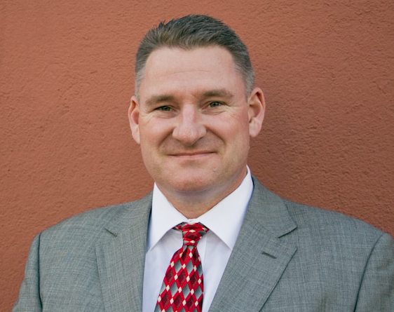
YOUR HOST
SEAN SPELLECY
SEAN SPELLECY: C.E.O. and Founder of NewDawn Security, 15 years of Security Experience,
10 years of Education Administration and Teaching Experience, Masters in ED.
Administration, Certified Protection Professional,
Association of Threat Assessment Professionals, Council Member A.S.I.S.
Nationwide School Safety and Security Council, School Violence Prevention
Council, and member of the Oregon School Safety and Security Officers
Association

Slide 11
RESEARCH
Protecting your Children From Sexual Predators, 2012, Dr. Leigh Baker
Protecting the Gift, 2008, Gavin DeBecker,
Identifying Child Molesters: Preventing Child Sexual Abuse by Recognizing the Patterns of Offenders, 2011, Dr. Carla Van Dam, Clinical and Forensic Psychology
The Socially Skilled Child Molester: Differentiating the Guilty From the Falsely Accused:
2011, Dr. Carla Van Dam, Clinical and Forensic Psychology
US Dept. of Juvenile Justice
US Dept. of Justice
National Sexual Violence Resource Center
Bureau of Justice Studies
31 Convicted Sexual Offender Interviews: Sean Spellecy 2006-2012

